Slide 1
PHILIPS CODE TO CARE CHALLENGE
Theme Chosen :
AI in Healthcare.
Problem Statement :
PNEUMONIA DETECTION ON CHEST X-RAYS WITH DEEP LEARNING.
Proposed solution in brief :
Developing a web app which takes chest x-ray as input and automatically detects pneumonia (14 different (types) thoracic pathology labels) even better than practicing radiologists. The prediction model is trained using VGG16 architecture.
Team Details :
1. NIRAJ SARODE
2. VAIBHAV SARAF
3. YASH BIYANI
4. PRANAV KULKARNI
Team Name : DEBUG ENTITY

Slide 2
Understanding of the Problem Statement :
Radiologist-Level Pneumonia Detection on Chest X-Rays with
Deep Learning
Chest X-rays are currently the best available method for diagnosing pneumonia. However, detecting pneumonia in chest X-rays is a challenging task that relies on the availability of expert radiologists.
Detecting pneumonia in chest radiography can be difficult for radiologists. The appearance of pneumonia in X-ray images is often vague, can overlap with other diagnoses, and can mimic many other benign abnormalities. These discrepancies cause considerable variability among radiologists in the diagnosis of pneumonia.
Here we’re presenting a solution that can automatically detect pneumonia from chest X-rays better than practicing radiologists.

Slide 3
Current situation in India and need of such diagnostic tool :
Providing quality health services and scaling to rural population in our country is extremely challenging
67% of Indian population resides in rural areas.
90% of medical imaging facilities are in the cities.
And there is ONLY 1 RADIOLOGIST PER 100,000 people.
Cardiovascular disease is the leading cause of death in India, and is becoming increasingly common among younger age groups: in India, 52 percent of cardiovascular deaths occur before the age of 70, compared to only 23 percent of deaths in Western populations.
Pneumonia in India accounts for 20 percent of the deaths worldwide caused by pneumonia.
Considering such aspects, Artificial Intelligence may be the breakthrough it needs and in order to address this situation, we are in a strong need of a computer aided diagnosis tool for quicker, efficient and detailed diagnosis.

Slide 4
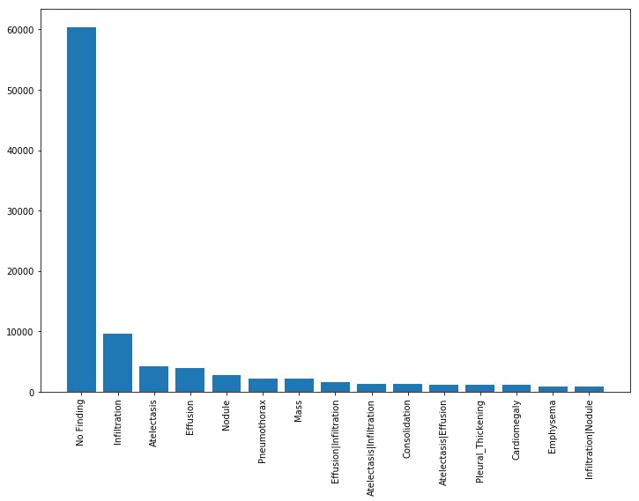
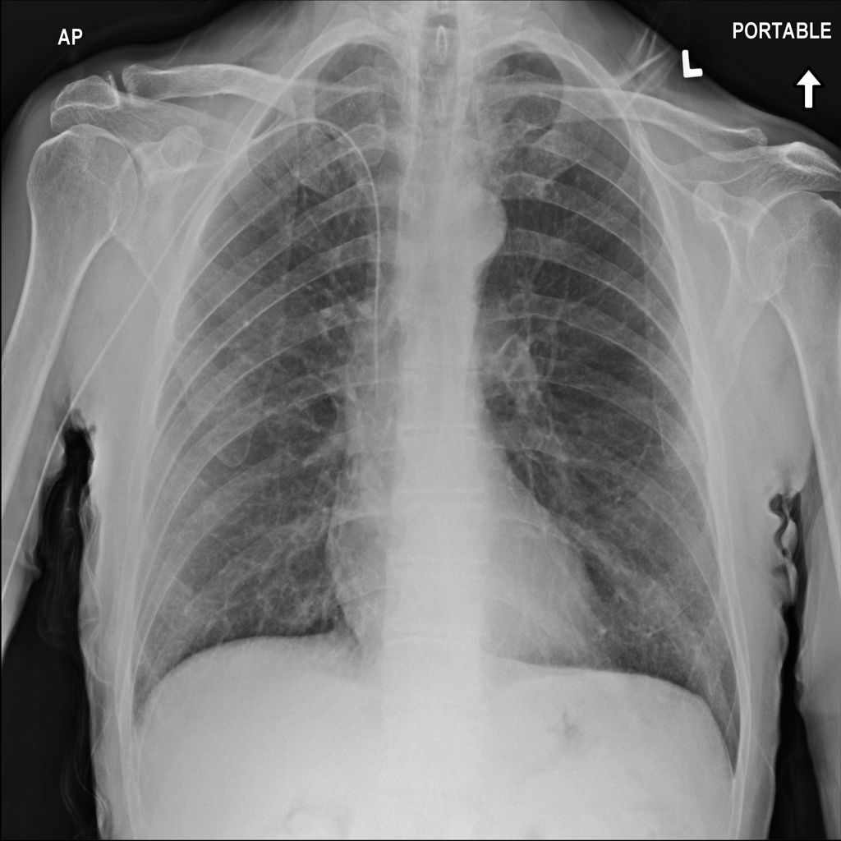
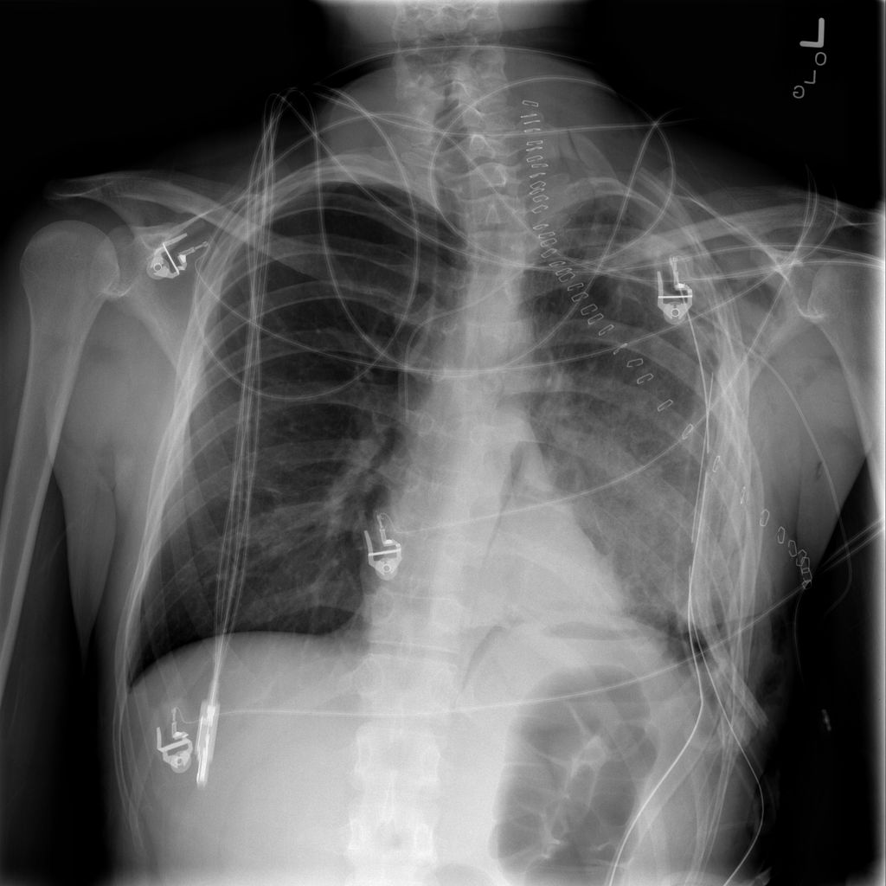
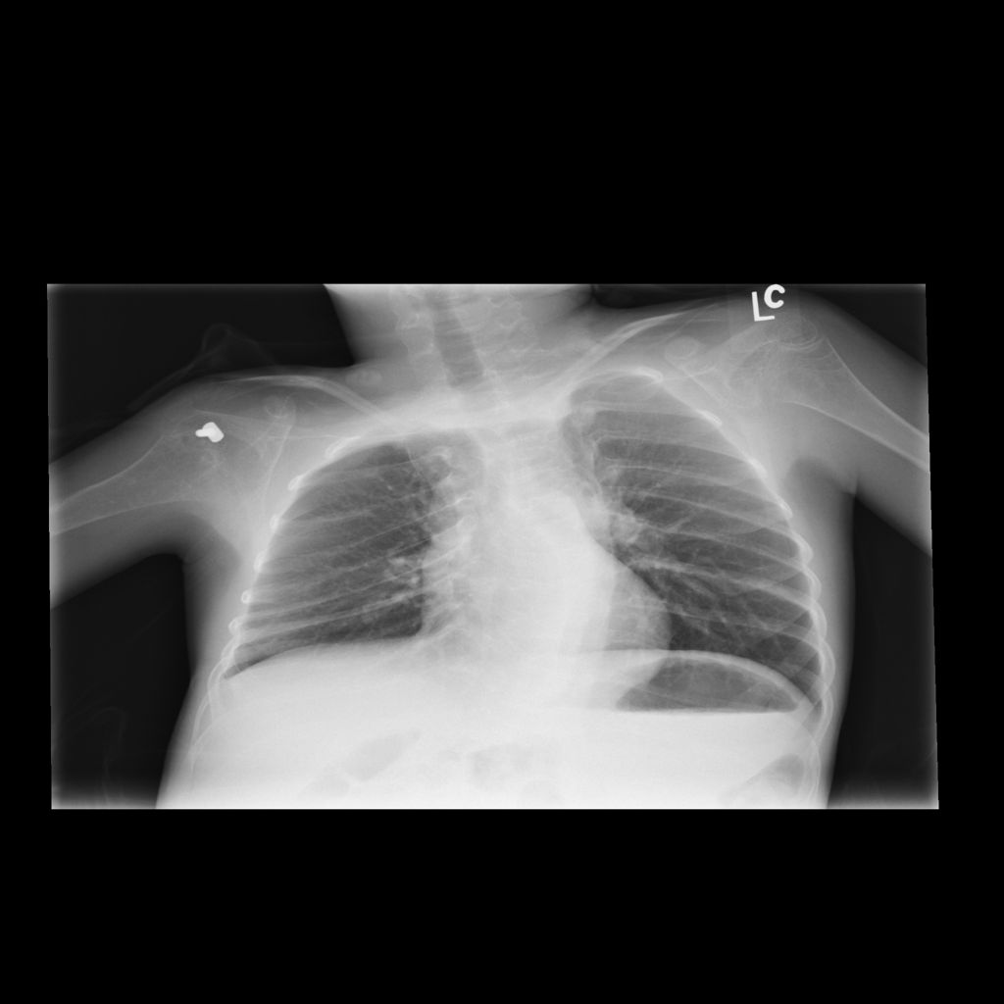
About the Dataset :
We have used ChestX-ray14 , the largest publicly available chest x-ray dataset released by NIH clinical centre.
The dataset contains 112,120 frontal-view X-ray images of 30,805 unique patients with labels belonging to 15 classes.
The dataset is annotated with up to 14 different thoracic pathology labels using radiology reports and a ‘No findings’ label.
The labels are expected to be >90% accurate and suitable for weakly-supervised learning.
Sample Images in Dataset :

Slide 5
Proposed Solution :
Data preprocessing :
Images in the NIH dataset are 1024x1024 in dimension which is first reduced to 224x224 for compatibility to VGG16 architecture.
All records in the csv file with ages greater than 100 were dropped.
We also augment the training data with random horizontal flipping.
Image indexes are replaced by corresponding image paths.
Training and validation data are splitted in 80-20 pattern.
2. Web app :
Front-end of the web app is designed in HTML5, CSS3, bootstrap, and JavaScript.
Back-end of the web app is designed using flask.
Prediction is done in back-end with the help of pickle saved state file (.pkl) which is produced by training the model beforehand.

Slide 6
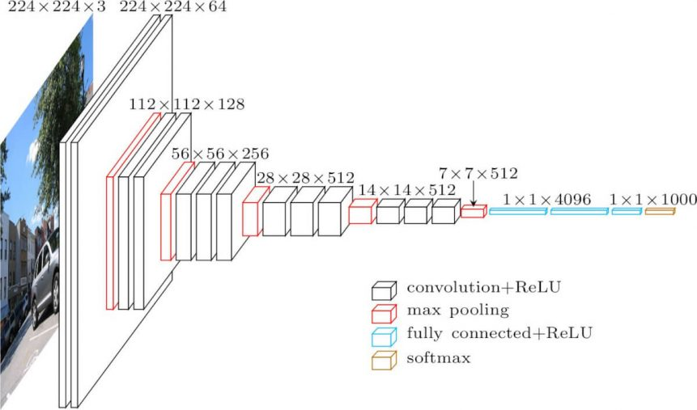
3. Model :
In our solution we are using VGG16 (convolutional neural network model) having only 3×3 convolutional layers stacked on top of each other in increasing depth.
Reducing volume size is handled by max pooling.
Two fully-connected layers, each with 4,096 nodes are then followed by a softmax classifier.
The “16” stand for the number of weight layers in the network.
Input to VGG: 224*224 RGB image and normalize based on the mean and standard deviation of images in the ImageNet training set.

Slide 7
Demo :
Note :If video not visible refer Demo video in the same folder

Slide 8
Future Scope :
Due to large dataset and lack of computing power we were restricted to use VGG-16, but use of densenet-169 can boost our models accuracy .
Recent experiments using ResNet model have also given promising results.
The NIH dataset is not clean. Many images are blur, wrongly labelled and skewed. More data preprocessing can also increase the efficiency.
Number of 'No finding’ labels are huge compared to other anomalies . Hence the model becomes more biased towards No findings. This problem can be solved by training the model on anomalies separately.
We are also planning to use Django in back-end to make the code more organized and easy to understand.

Slide 9
Impact and Applications:
This application can determine the exact place of abnormality and highlight it which , in turn, will reduce errors in diagnosis and make the process far more easy.
Current load on radiologists all over the world will decrease significantly.
Due to early primary diagnosis, priority treatment can be given to patients with comparably more severity of the disease.
Efficient patient management in areas with less number of radiologists can be implemented by forwarding only those patient reports with anomalies.
Diagnosis process can be carried out 24 hours a day for the whole year.
Cost of such diagnosis will also decrease considerably.

